Slide 1

Smart Safety Measurement protocols : Alcohol & drowsiness detection
Bachelor of Science ( honours) in Computer Science
This project has been done by
Ahana Goswami (213135-11-0052 )
Ishika Das ( 213135-11-0141)
Madhumita Saha ( 213135-11-0053)
Ronit Dey ( 213135-21-0046)
Under the Supervision of Professor Soumita Chakraborty

Slide 2

HIGHLIGHTS >>>>>
Alcohol detection capability
Drowsiness detection capability

Slide 3

Content >>>>>
Introduction
Main component
Methodology
Circuit Connection
Implementation
Result
Review
Future Scope

Slide 4

Introduction>>>>>
Nowadays IoT is widely used in day-to-day life. In open or closed a situations.
We have built this application for the domestic purpose which will detect the Alcohol and also detect the Drowsiness and give a alert.
Our system also continuously monitor the total environment. This type of automatic security system can save people from dangerous accident.

Slide 5
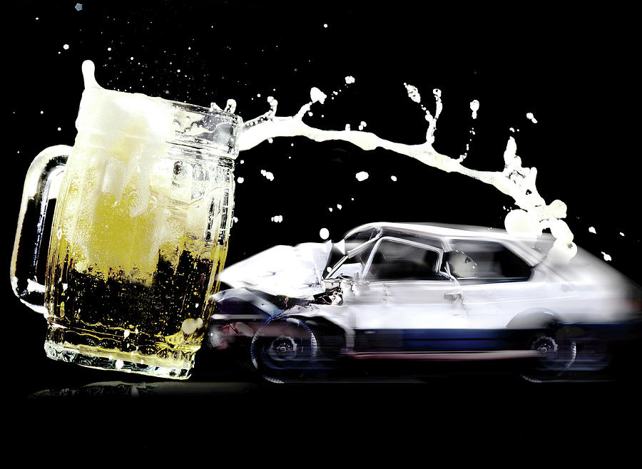
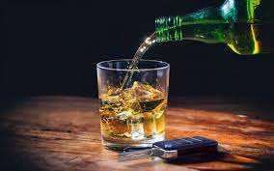
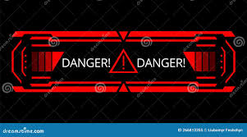
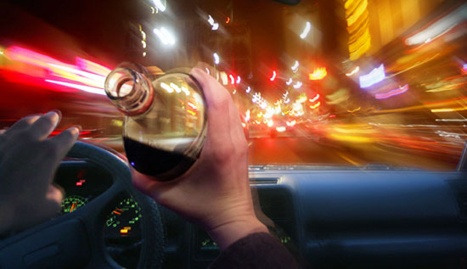

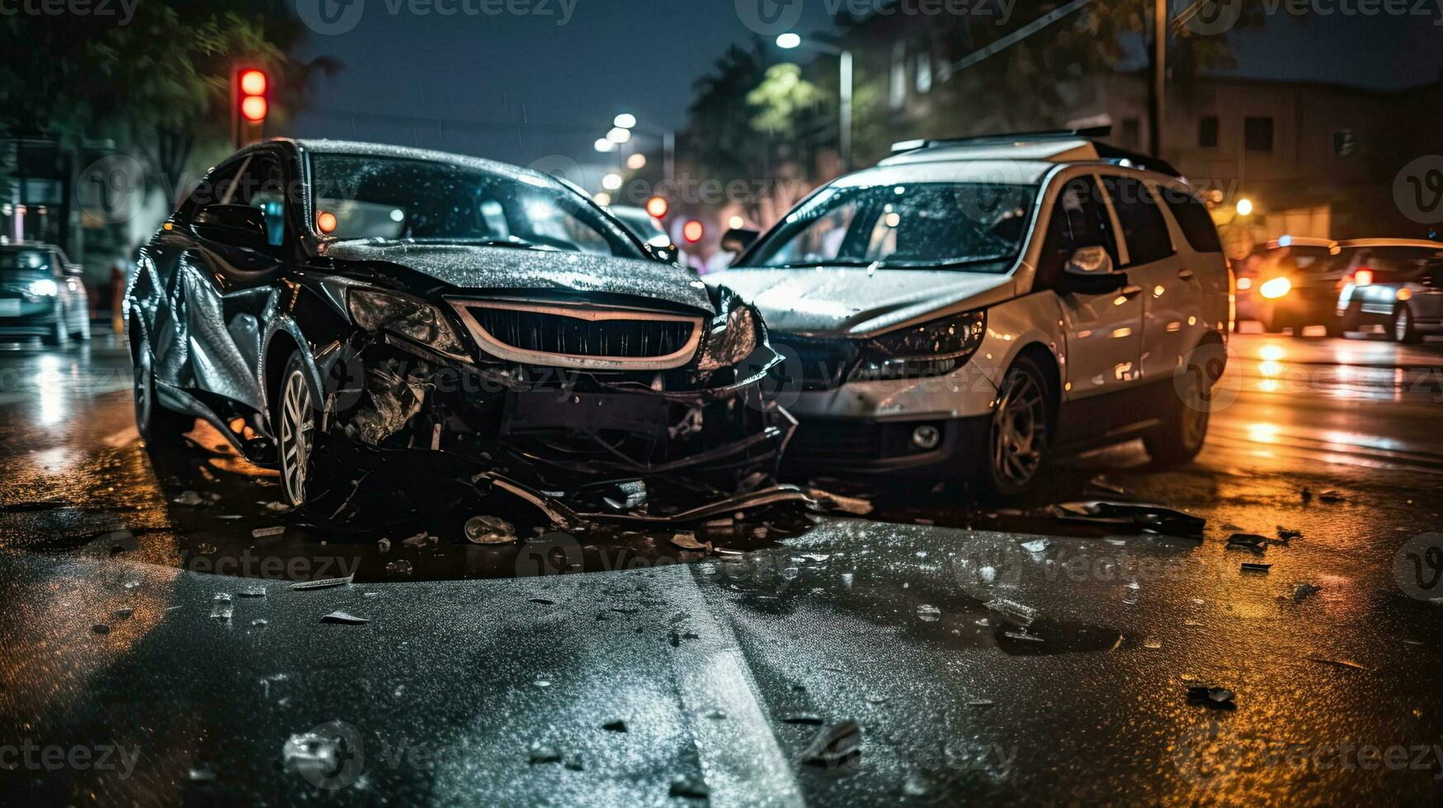

Slide 6
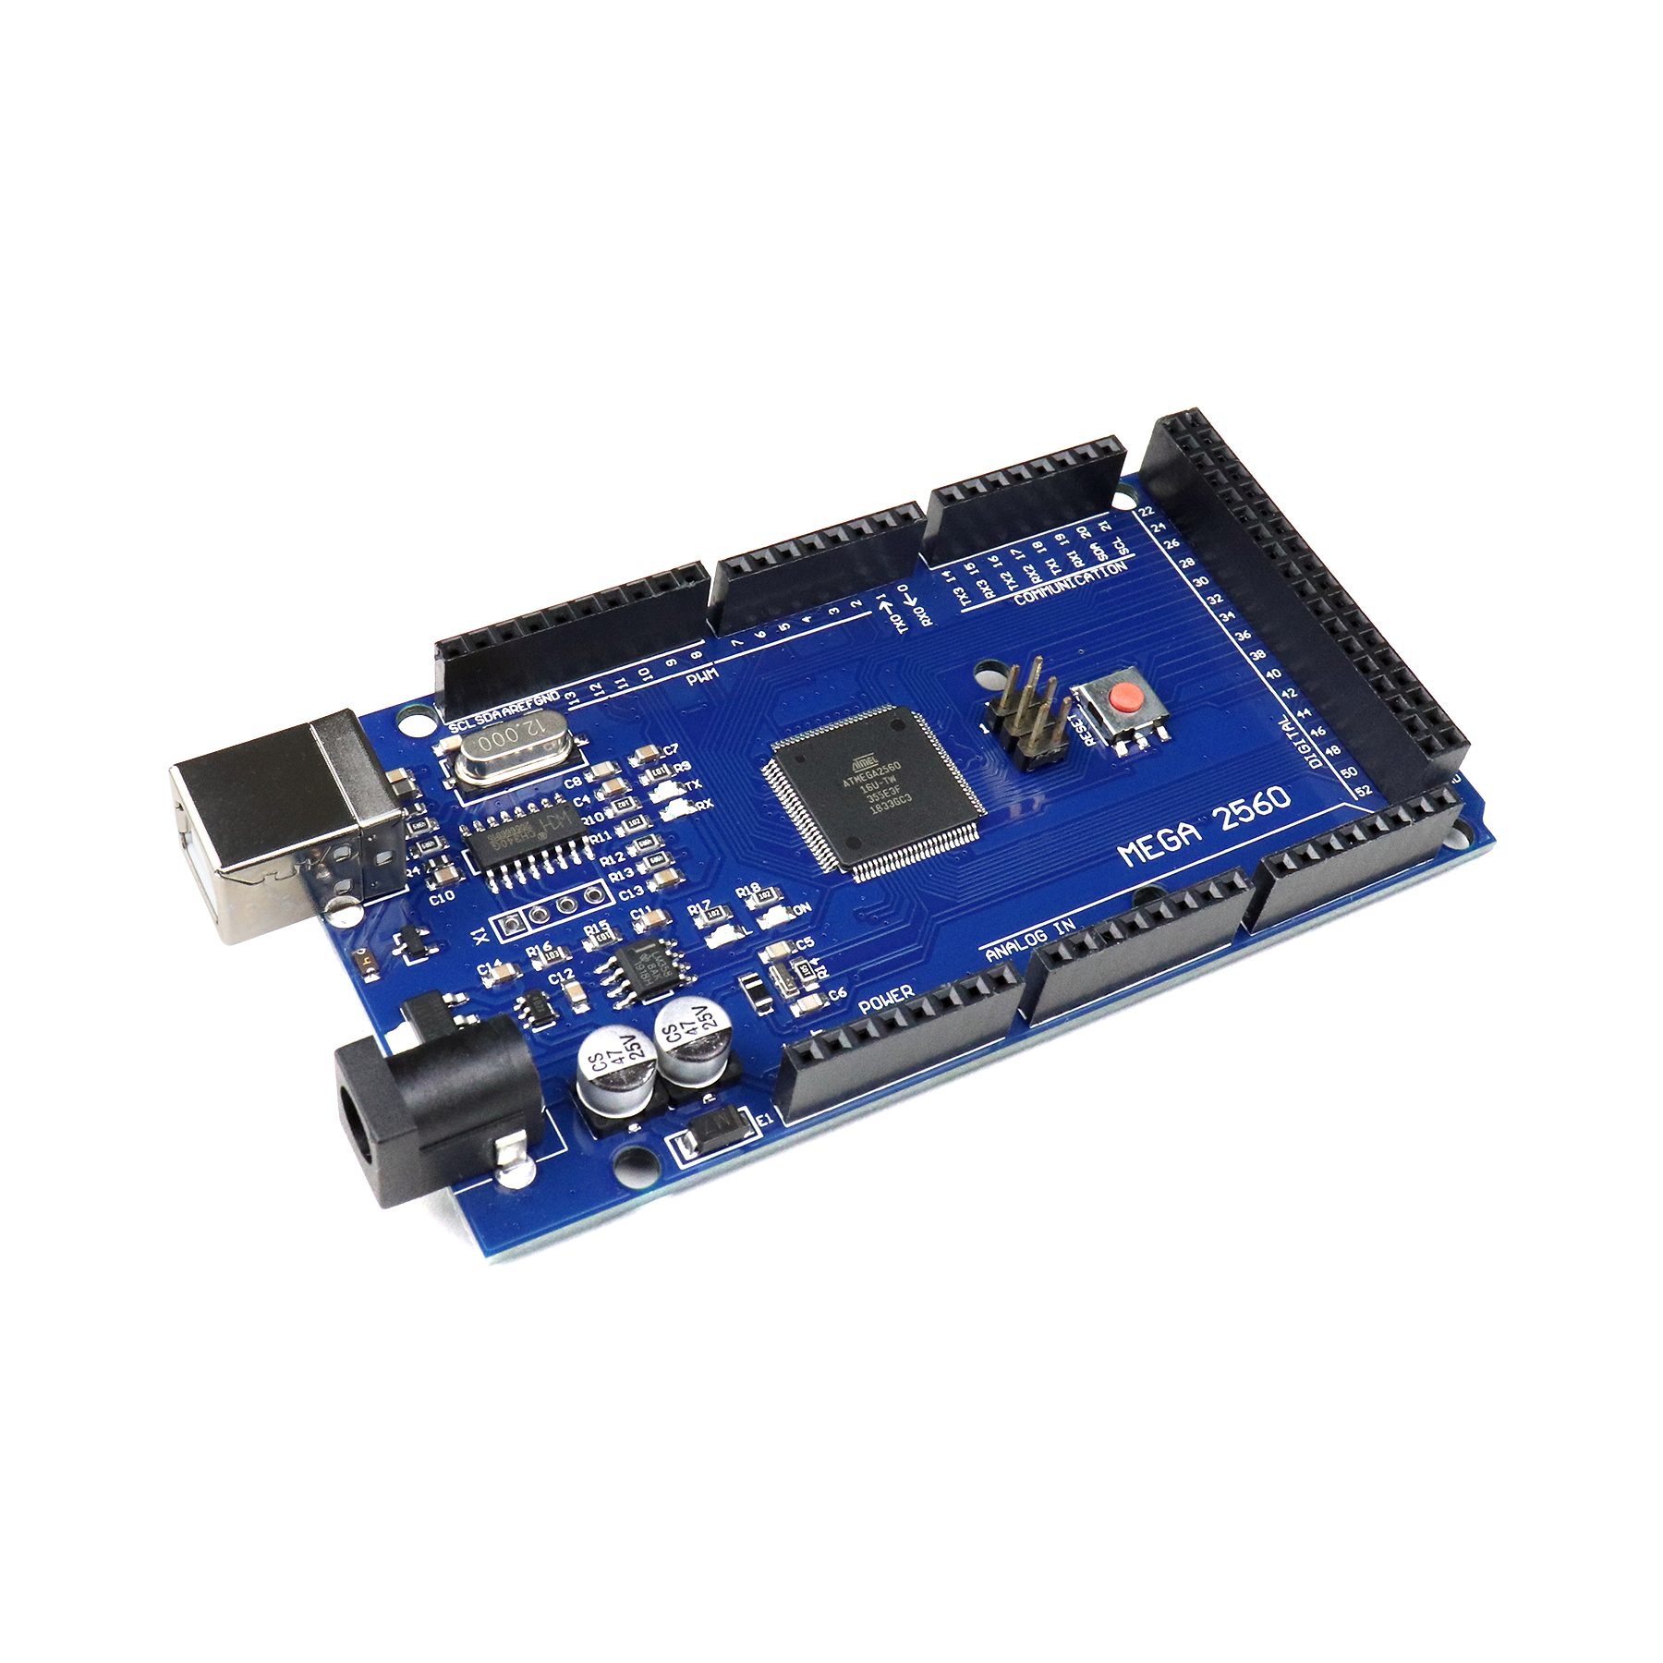
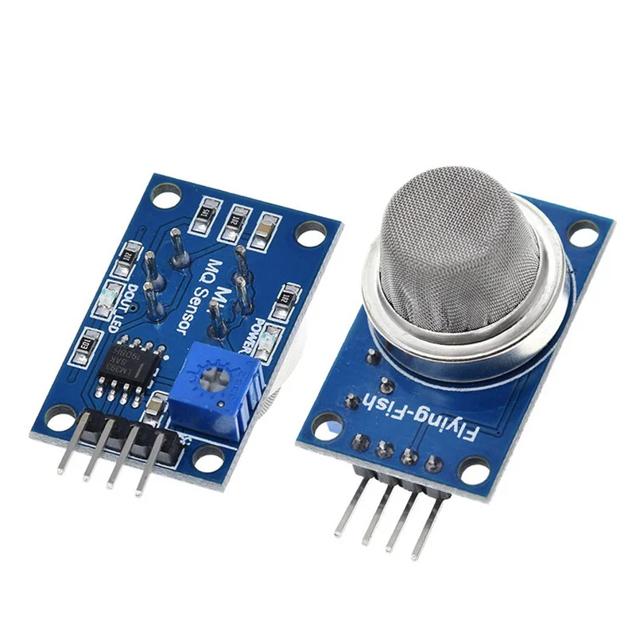
Main component>>>>>
Arduino Mega
Alcohol detection
(MQ 135)

Slide 7
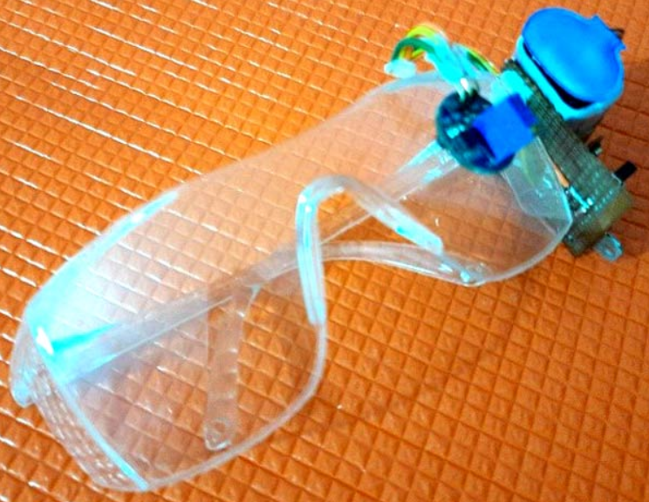
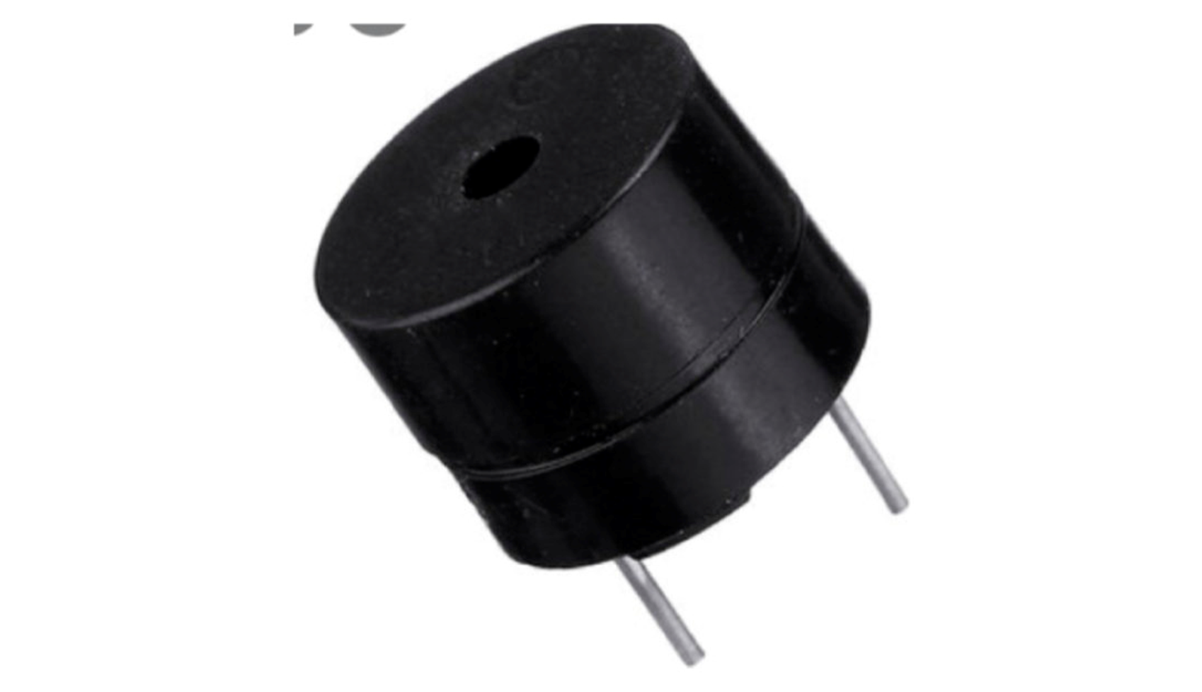
Eye blink sensor
Buzzer

Slide 8

Methodology>>>>>
Alcohol detection
Start
If
Alcohol & eye blink
Yes
Buzzer will ring
Drowsiness
detection
No
Stop
Buzzer will not ring

Slide 9

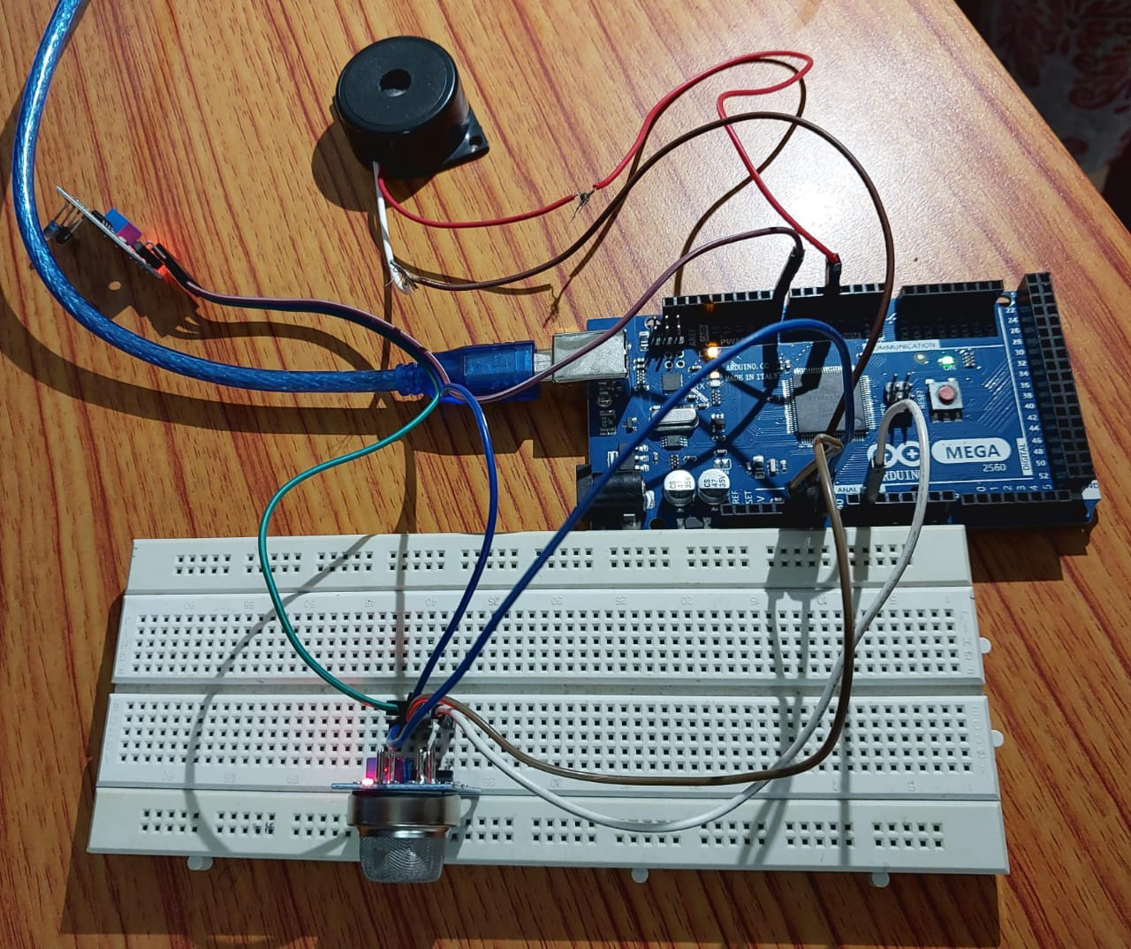
Circuit connection>>>>>

Slide 10
Implementation>>>>>
Alcohol detection sensor (MQ 135) – It read the value of the alcohol from the sensor pin and print the value o the screen and then the BUZZER will ring.
Eye blink sensor – The eye blink sensor is used to detect the eye blinks and using which we can also detect the activities like the Drowsiness of the driver while driving.

Slide 11
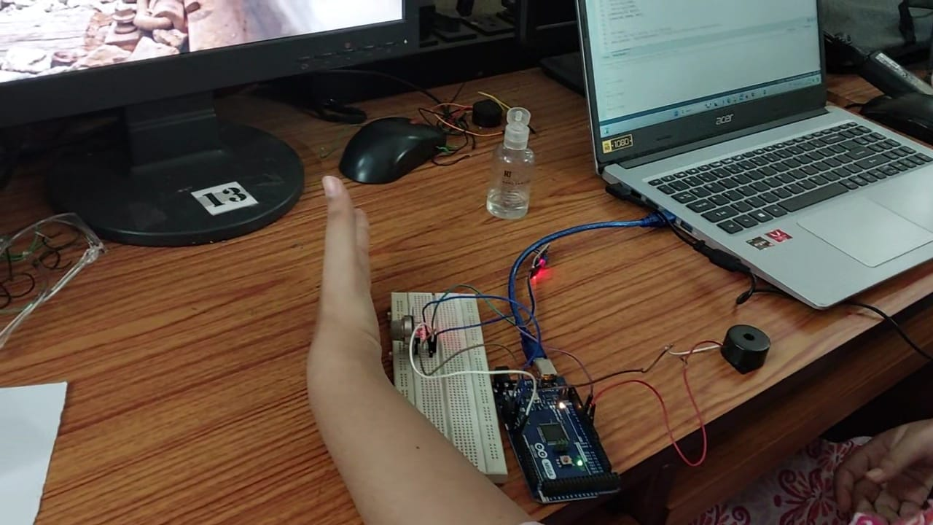
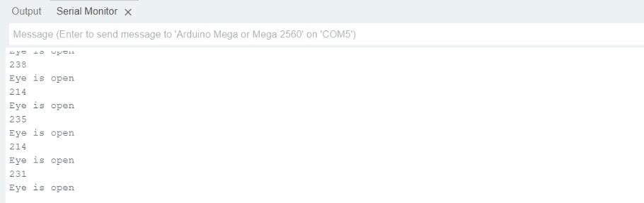
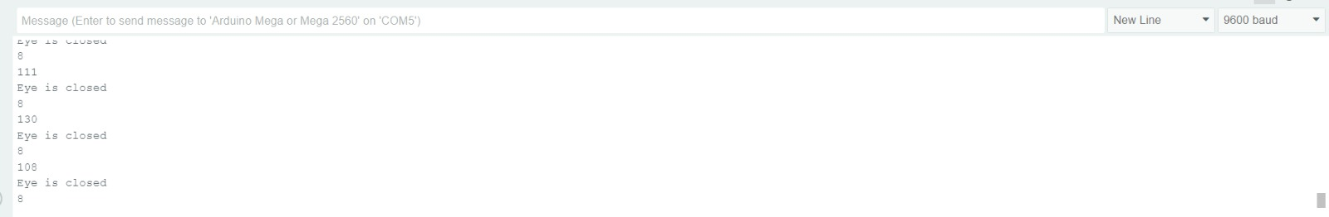
Result>>>>>
Alcohol detection

Slide 12
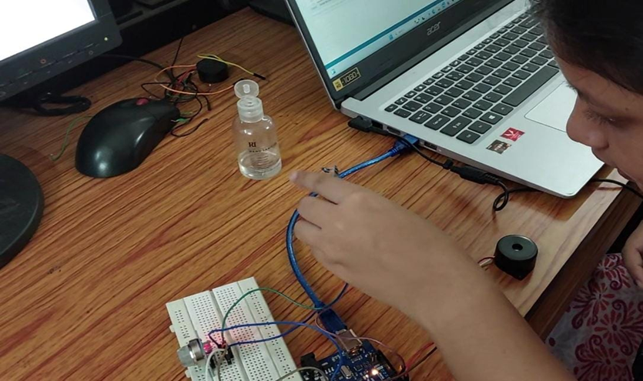

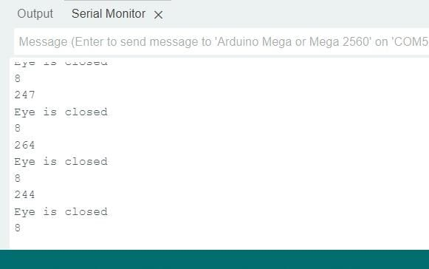
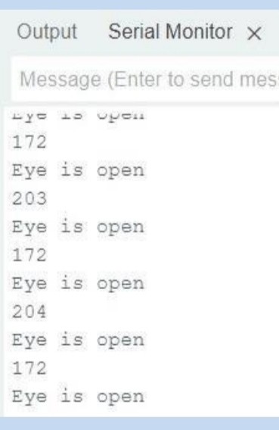

Slide 13
Review>>>>>
E. Ahmed et al. (2020): This study presents a system that integrates an MQ-135 alcohol sensor with an Arduino microcontroller to detect alcohol levels in the air inside a vehicle, which can trigger actions like disabling the ignition system
N. Kumar et al. (2021): This paper presents a system combining alcohol detection sensors and camera-based eye tracking to monitor drivers for signs of alcohol use and drowsiness, with alerts and vehicle control interventions.
V. Patel and M. Shah (2020): This paper presents a dual-system approach that uses a combination of facial recognition for drowsiness detection and alcohol sensors to monitor intoxication levels in drivers.
S. Lee et al. (2019): The study develops a system integrating alcohol sensors and eyelid movement tracking to provide real-time alerts and interventions to enhance vehicle safety.
M. D. Santos and A. J. Cruz (2021): This study utilizes machine learning algorithms to analyze sensor data for detecting alcohol and drowsiness, offering improved prediction accuracy and early warnings.

Slide 14
future scope>>>>>
Integration with wearable devices : Integrating the system with wearable device like smart watch or fitness trackers allows driver to be alerted.
Mobile Application :User can monitor alcohol and drowsiness detecting data in real time, receives alerts on their smart phone .
Enhanced Detection Algorithms: Develop more advanced algorithms using machine learning and AI to improve the accuracy of alcohol and drowsiness detection by learning from diverse data sets.
Expansion to Other Impairments: Extend the system to detect other impairments, such as drug use or medical conditions (e.g., epilepsy), that may affect driving ability.

Slide 15

Thank you

